Slide 2

DevOps Beyond the Tools DevOps Enterprise Summit London
Credit Suisse AG
IT Strategy & Architecture
Andrea Hausmann
Duncan Lawie
June 2020

Slide 3
Credit Suisse Founded 1856
Key figures (as of end-2019)
47860 employees
3540 relationship managers globally
1507 bn CHF Assets under Management
We serve our clients through three regionally focused divisions:
Swiss Universal Bank
International Wealth Management
Asia Pacific
These regional businesses are supported by two other divisions specializing in investment banking capabilities:
Global Markets
Investment Banking & Capital Markets

Slide 4
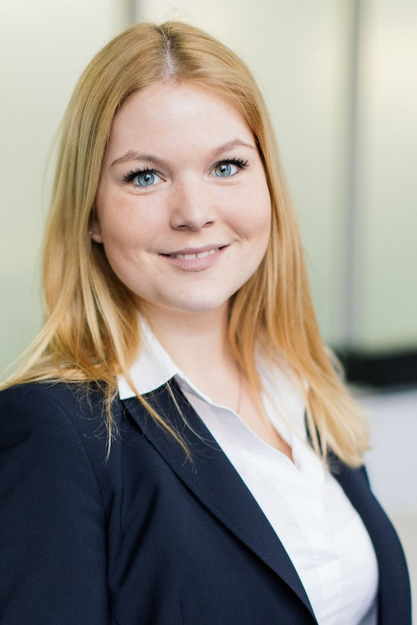
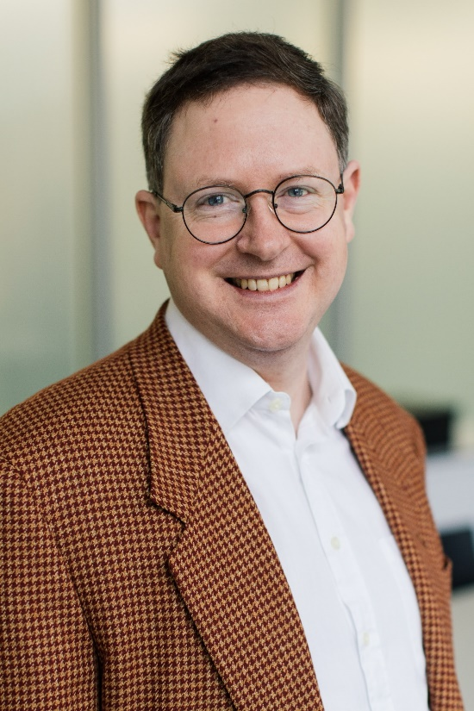
Meet the Speakers Andrea & Duncan
Andrea Hausmann
Head of Program Strategy & Engagement
DevOps & Development Practices Group, IT S&A, Credit Suisse
Duncan Lawie
Head of Strategy & Governance
DevOps & Development Practices Group, IT S&A, Credit Suisse

Slide 5

Working at a Bar Tools, Tools, Tools
Beautiful newly reopened bar in Swiss mountain village Zermatt

Slide 6
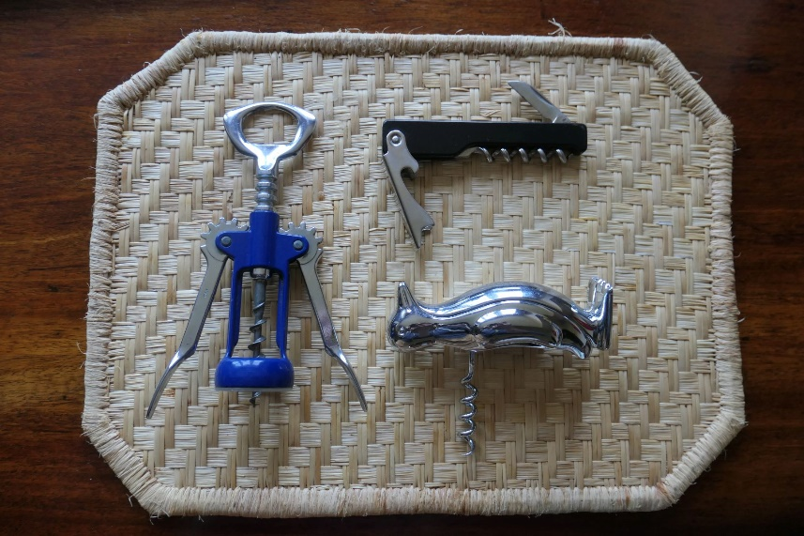
Working at a Bar Tools, Tools, Tools
Beautiful newly reopened bar in Swiss mountain village Zermatt
Tools: Which one to buy?
Stability
Sustainability
Ease of Usage
Speed
…

Slide 7

Working at a Bar Tools, Tools, Tools
Beautiful newly reopened bar in Swiss mountain village Zermatt
Tools: Which one to buy?
Stability
Sustainability
Ease of Usage
Speed
…
Providing best service to customer, while having a great time!

Slide 8

Crunching Numbers Tools, Tools, Tools
Graduated in Business Mathematics from university

Slide 9

Crunching Numbers Tools, Tools, Tools
Graduated in Business Mathematics from university
Tools: How to visualize the insights?
Stability
Sustainability
Ease of Usage
Speed
…

Slide 10

Crunching Numbers Tools, Tools, Tools
Graduated in Business Mathematics from university
Tools: How to visualize the insights?
Stability
Sustainability
Ease of Usage
Speed
…
Providing best service to customer – so that informed decision can be taken, while having a great time!

Slide 11


A DevOps Working Group People are People

Slide 12
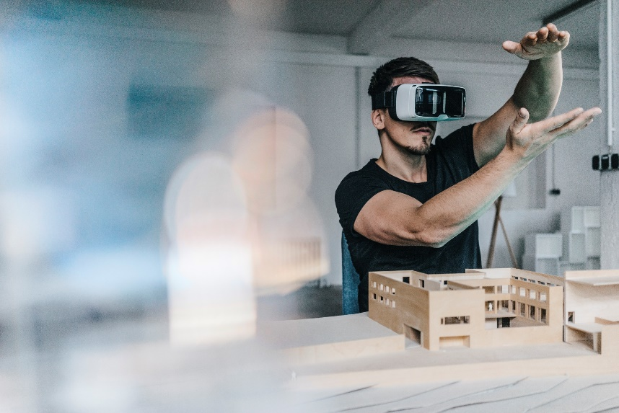
A DevOps Working Group People are People
Technology: cool toys!

Slide 13

A DevOps Working Group People are People
Technology: cool toys!
Process: it took us years to understand, design and build

Slide 14

A DevOps Working Group People are People
Technology: cool toys!
Process: it took us years to understand, design and build
People: it’s hard work changing minds, changing culture

Slide 15


Power, Politics and Protection People are People

Slide 16

Managing what you want to Measure People are People

Slide 17

Learning how to Measure People are People

Slide 18


A DevOps Satisfaction Survey People are People

Slide 19

Central DevOps Toolchain for Credit Suisse Tools, Tools, Tools
Through vision and engagement a central toolchain got developed

Slide 20

Central DevOps Toolchain for Credit Suisse Tools, Tools, Tools
Through vision and engagement a central toolchain got developed
Competing solutions arise
Ever lasting discussions about different options, tools, usage, extensions,..

Slide 21

Central DevOps Toolchain for Credit Suisse Tools, Tools, Tools
Through vision and engagement a central toolchain got developed
Competing solutions arise
Ever lasting discussions about different options, tools, usage, extensions,..
Together one solution through common understanding from all

Slide 22

Individual, Team and Customer Goals Balance
What keeps the individual interested?

Slide 23

Individual, Team and Customer Goals Balance
What keeps the individual interested?
What keeps the team in synch?

Slide 24

Individual, Team and Customer Goals Balance
What keeps the individual interested?
What keeps the team in synch?
What does the business need?

Slide 25

Hire Engineers – but not only Balance
The Engineers numbers must increase – generating the actual value

Slide 26

Hire Engineers – but not only Balance
The Engineers numbers must increase – generating the actual value
Keep diverse ideas and mindsets at work

Slide 27

Hire Engineers – but not only Balance
The Engineers numbers must increase – generating the actual value
Keep diverse ideas and mindsets at work
What is the ultimate goal?

Slide 28

The Impact Balance
“
Andrea has been closely integrated in the Credit Suisse DevOps initiative and has helped drive this transformation and to achieve meaningful results; especially in Zurich and on cultural efforts
-- Stephan Hug
Head of IT Strategy & Architecture
Thanks for your excellent presentation, Duncan. Possibly the clearest and best articulated I’ve heard in the last year or two on this topic
-- John Burns
Head of IT Global Site Strategy & Delivery
I’m really impressed with the way you guys have replied to the survey submissions
-- Finnbar Cunningham
Head of Grid Computing
The DevOps Program has served to ingrain a common set of goals across Credit Suisse IT, while igniting a transformational shift in our organisational culture and mindset
-- Laura Barrowman
Group CIO
”
“
”
“
”
“
”

Slide 29

More Mountains to Climb The journey continues
How do you keep focus on core engineering activities over context?
How do you talk about happiness in your organisation?
How do you test whether the message is reaching through the whole company?

